Slide 1

A Hitchhikers Guide to Scrum

Slide 2
What we will cover
The Agile Manifesto
What is Scrum?
The Core Values of Scrum
Ceremonies, Roles, and Artifacts
Common Sources of Waste in Scrum
Your Questions

Slide 3
The Agile Manifesto
We are uncovering better ways of developing software by doing it and helping others do it. Through this work we have come to value:
Individuals and interactions over processes and tools Working software over comprehensive documentation Customer collaboration over contract negotiation Responding to change over following a plan
That is, while there is value in the items on the right, we value the items on the left more.

Slide 4

Scrum is an Agile Framework
Scrum is a framework within which people can address complex adaptive problems, while productively and creatively delivering products of the highest possible value.

Slide 5
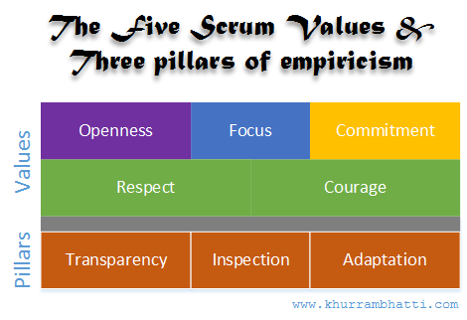
But Uncle Rob, HOW?!?!?!?!!?

Slide 6
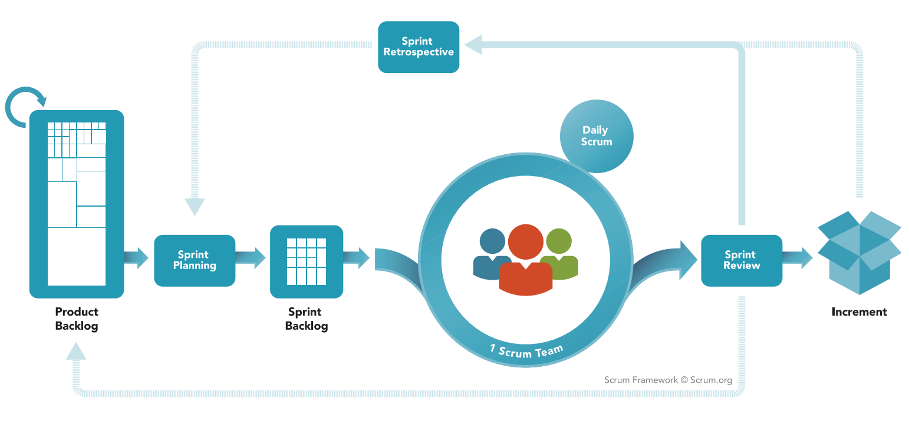
Scrum Ceremonies
*Always timebox & always have an artifact

Slide 7


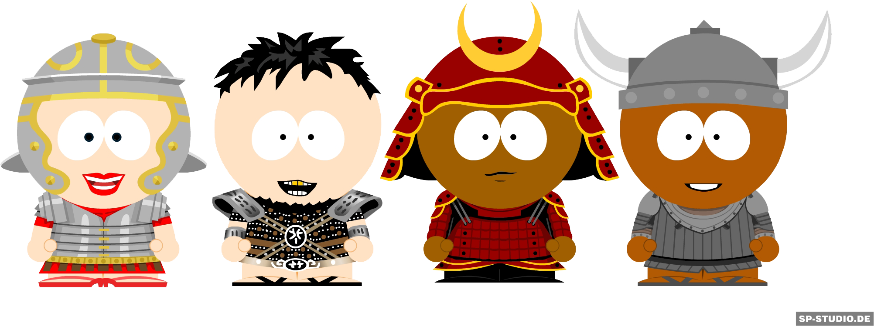
The Scrum Team
The Product Owner
One Person
Value Driver
Backlog Maintainer
Accepts Work Increments
Scrum Team Teacher
Needs Organizational Buy-In
The Scrum Master
Master Of Ceremonies
Champion of Scrum
Impediment Remover
Agility Coach
Servant Leader
No Official SM Here…
The Development Pod
Self-Organizing
Cross-Functional
Executes Sprint Goal
Empowered
Not Just “Developers”
Providers of HOW

Slide 8
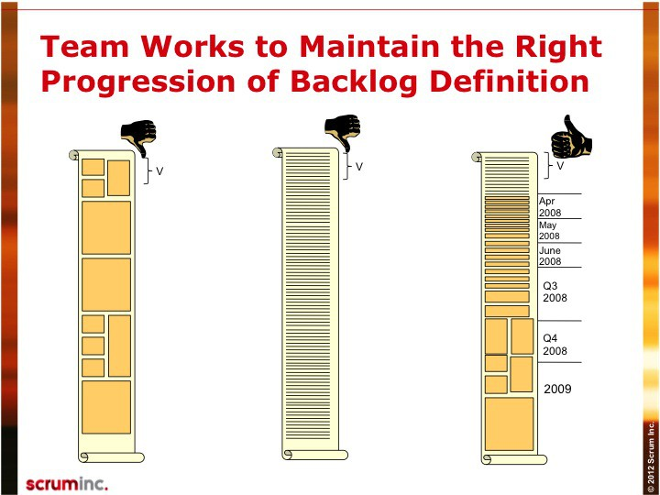
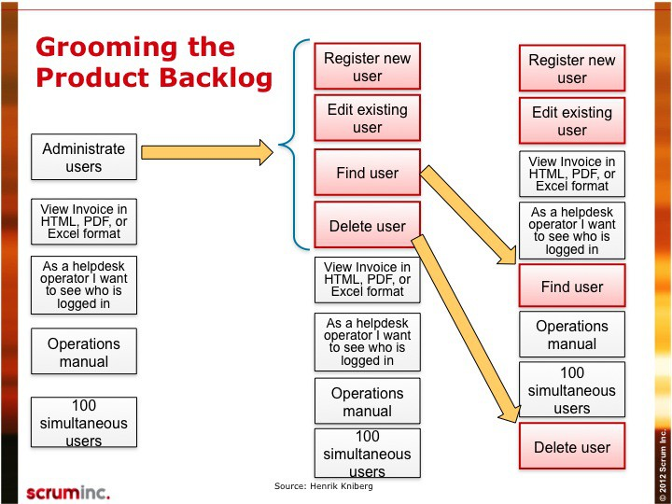
The Product Backlog
Starts with Initiatives - distributed from Enterprise Portfolio Level
Organized Top-Down - by business value and dependency
More detailed at the top - Detailed Stories -> Broad Stories
The next two full sprints of velocity should be ready or very near ready for planning
Should be formed as part of Release Planning if needed

Slide 9
Release Planning & Grooming
Release Planning breaks iterations into themes high-level stories
Done outside of the typical Sprint ceremonies
Some of this is done during quarterly planning
This activity should engage your stakeholders, customers and users
This can be done without your development team, but it can be very wise to include them
Very high-level stories, with high-level story point estimates (work with your team to define very high-level story points)
During release planning, the inner details (small stories and ACs) should not be discussed (**just in time planning)
Release planning can shape insight into release targets for your backlog (these are still estimates)
Grooming takes highest value items in the backlog and move them towards the Definition of Ready
Grooming is not an official Scrum ceremony
Grooming may not be needed, if proper time is spent on planning your iterations

Slide 10
Sprint Planning
On newer teams, this meeting should be scheduled for 2 hours per each week of your iteration
2 week iteration = 4 hour planning session
Meeting Artifact: Next Sprint Backlog (sprint backlog != product backlog)
Typically a two-part meeting
Part 1 (the Pitch)
Product owner gives an overview of the Sprint Goal
Sprint Goal is a singular, focused idea of what this sprint should be focused around
Product owner should go over each story they would like to target during the sprint
Focus on the WHY
Dev Team asks qualifying questions about the story (acceptance criteria, if necessary)
If the Dev Team has not provided story point estimates for the stories, this can be done after each story is presented
Part 2 (the Plan)
Team breaks each story into tasks
Tasks are given “ideal days” estimates by the Dev Team
Once the team has committed to a story, it is added to the sprint backlog
Only the Dev Team can decide how much work to take on in a sprint
Once the entire sprint backlog is created, tasked, estimated and in the sprint, the sprint can be started
Each story should meet the Definition of Ready for your team

Slide 11
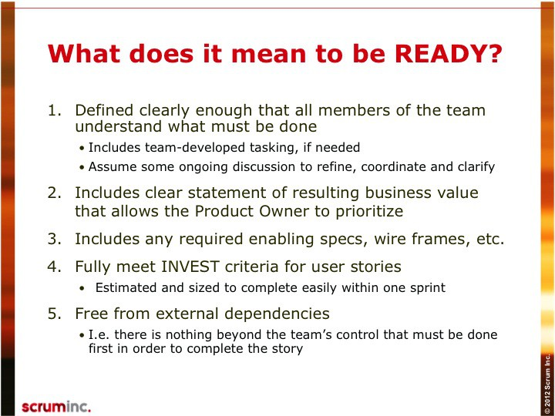
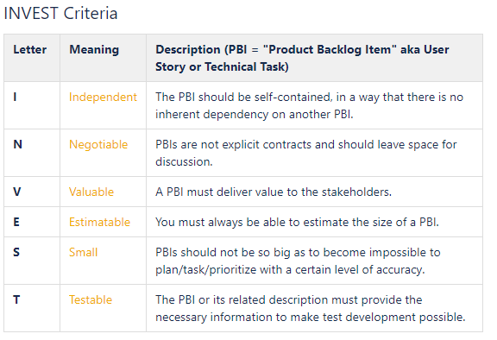
Definition of Ready

Slide 12

Estimation
Story Pointing
Relative Sizing
Planning Poker (there are apps for that!)
Comparison pointing (UI, Business Logic, Data Sourcing, Testing)
Ideal Days
If I could work completely uninterrupted it would take X days to complete this task
Accuracy vs. Precision

Slide 13
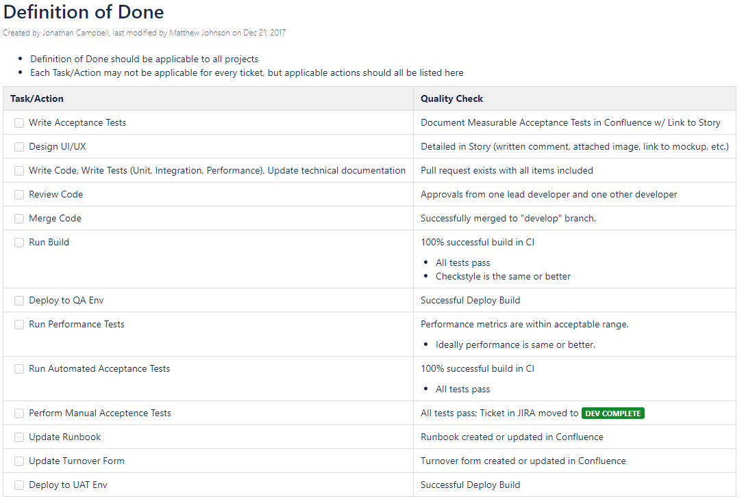
Definition of Done

Slide 14
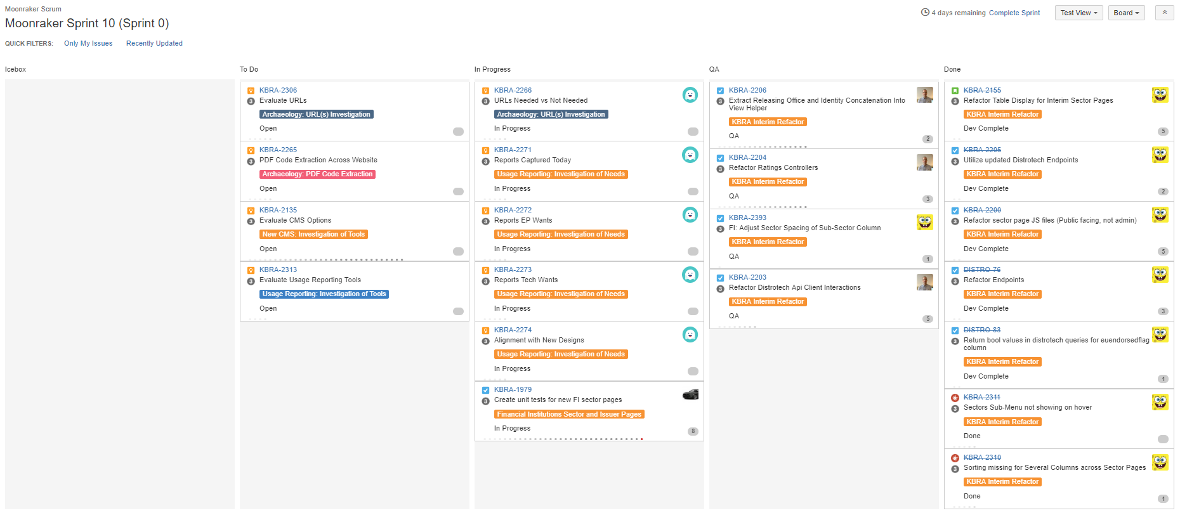
The Sprint Backlog
The Sprint is a commitment between the team and product owner to get a potentially shippable increment
This includes asking team members to do out-of-band work during a sprint
Once a Sprint is started, the entire Scrum Team should guard vigilantly against altering the sprint backlog
If a higher-priority story is created it could be “traded out” for an item of equal value
The team should not “throw things over the wall”

Slide 15
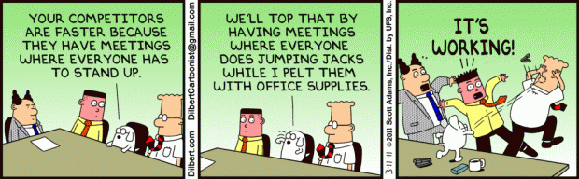
The Daily Standup
The daily standup is a 15 minute, timeboxed meeting which occurs every day
People usually stand, to imply the shortness of this meeting
Teams typically start with this, though ending the day with it can also be effective
Each Dev Team member takes a turn and describes the following
What I did yesterday
What I plan to do today
Impediments which are or will block progress
This is NOT a status meeting
It IS a way for other members of the scrum team to help each other clear obstacles, don’t seek to solve the impediments, just identify them and follow up “offline” when solutions are needed

Slide 16

The Sprint Review
At the conclusion of the sprint (not always?)
Dev Team reviews work done w/ PO
Did each item meet the Definition of Done
Environments should be pre-tested and isolated during the Sprint Review (don’t demo from UAT and push code to it during the review)
PO gives a stamp of approval or rejects the story
PO should be reviewing work with the team as it progresses during the sprint, if you’re PO is seeing the work for the first time at the review, there might be a problem
Meeting Artifact: Potentially Shippable Increment
Accepted stories are your potentially shippable increment
Scrum does not imply releases every sprint
PO should clarify when releases should occur and those should be planned for (E2E process transparency)
Stakeholders and other involved business members invited
Can also review sprint stats with Scrum Team
Committed vs Completed
Sprint Scope Change
Overall progress against initiative/epic/theme

Slide 17
The Sprint Retrospective
Easy to understand, extremely hard to master
Usually conducted by Scrum Master
Focuses on identifying and addressing challenges the Scrum Team faces
Should have SMART goal action items w/ an accountable party
Specific (simple, sensible, significant)
Measurable (meaningful, motivating)
Achievable (agreed, attainable)
Relevant (reasonable, realistic and resourced, results-based)
Time bound (time-based, time limited, time/cost limited, timely, time-sensitive)
Be creative with Retros, don’t always follow the same format
Engage your entire team, not just the loudest voices in the room
This meeting is the best tool in the framework for improving the overall process
Watch for anti-patterns
One voice dominating
No goals/action items
Finger pointing vs problem solving
If only the people not here did better…

Slide 18
Common Sources of BIG Waste
Conflicting business priorities
Over allocation – multi-tasking of team members
Delivery of customer needs too late – long wait cycles
No ROI or value measurement or tracking
Unproductive/wasteful meetings
No end-to-end process visibility or optimization
Over production – working on non-valuable projects
Tactical Focus
Feature envy – not spending enough effort on the overall quality of things through automation etc.
Firefighting – being reactive to quality issues

Slide 19
Common Sources of BIG Waste
Lack of communication, collaboration, trust
Within teams and cross-functionally
Lack of a generalizing specialist
Working in Silos – hand-offs and red tape
Working on bad missing or changing requirements
Unnecessary or heavy processes and documentation
Small large and daily impediments
Disengaged employees, stakeholders and customer
Remember this is just a framework, how well you use it is up to you
Questions…

Slide 20
More Information Available
KBRA Wiki
http://wiki.kbra.network/wiki/display/PMO/Agile+Home+Page
http://wiki.kbra.network/wiki/display/PMO/Estimating
http://wiki.kbra.network/wiki/display/PMO/Definition+of+Ready
http://wiki.kbra.network/wiki/display/DEV/Definition+of+Done
http://www.scrumguides.org/scrum-guide.html
https://www.scrum.org/
https://www.mountaingoatsoftware.com/
https://www.mountaingoatsoftware.com/tools/velocity-range-calculator
https://www.youtube.com/user/AgileTrainingVideos

